Slide 1
Fundamental project
22MayENABLE2

Slide 2
Introduction:
This is the week 5 project which is to create a inventory management system. In the inventory management system the functionality in the system will be : customers; items; and orders.

Slide 3
Minimum requirements:
The minimum requirements are the following:
-fully integrated code in a version control model using future brand model
-a relational database on SQL
-a functional application which meets the requirements of the project
-JUNIT testing
-doumentation

Slide 4
Consultant Journey:
The consultant journey includes the following:
-version control system (git)
-source code management (github)
-Kanban board (jira)
-database (mysql)
-programming language (java)
-build tool (maven)
-testing (JUNIT and maven)
-versioning (github)

Slide 5
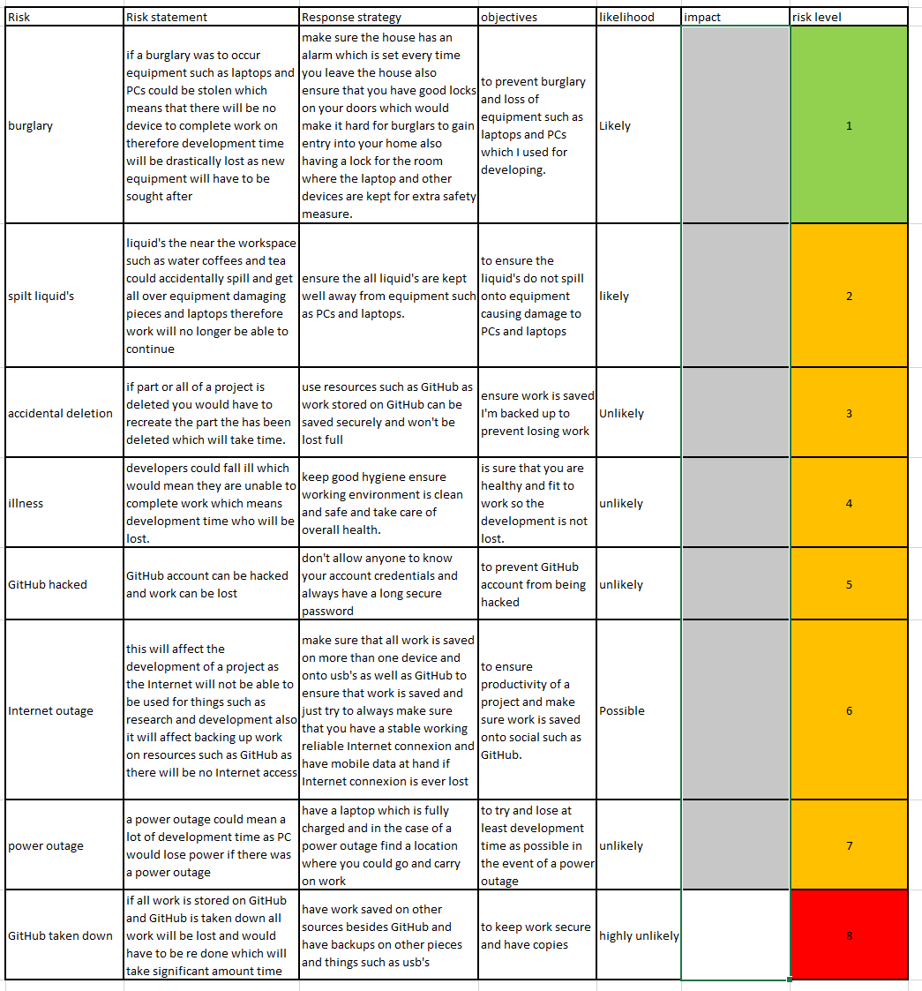
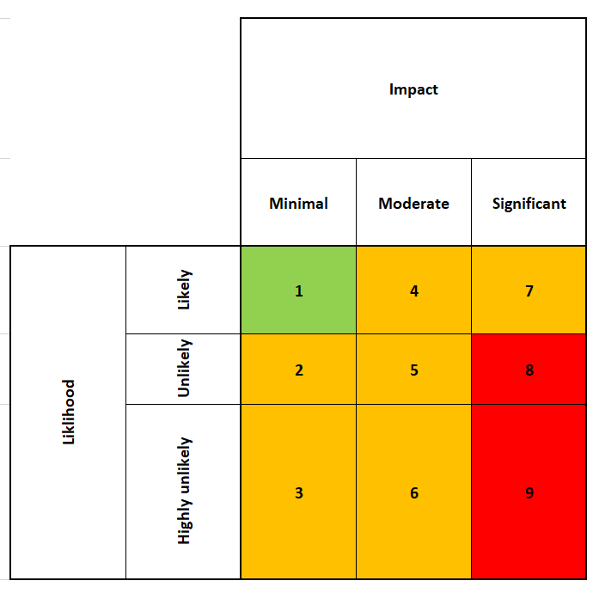
Risk assessment

Slide 6
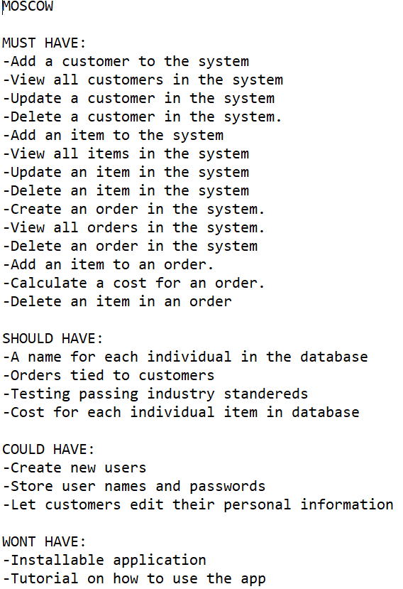
MoSCoW:

Slide 7
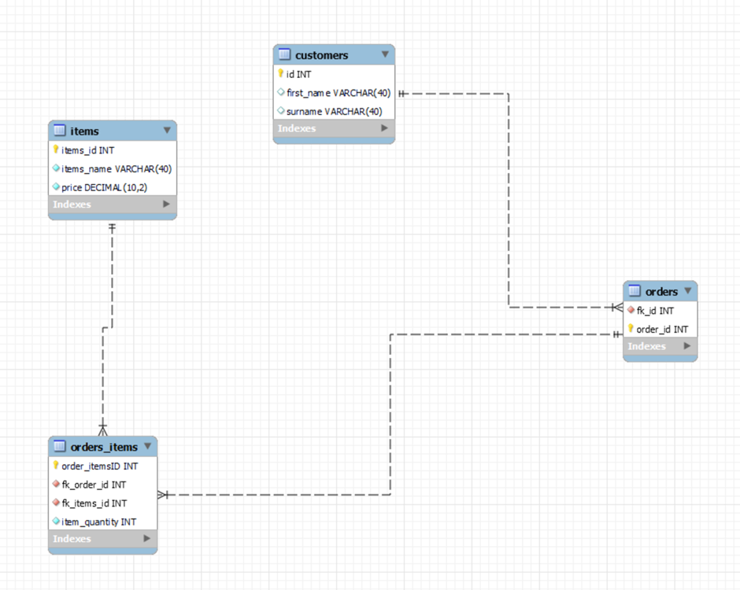
ERD:

Slide 8
Testing:
Testing still in progress as there are errors in code that needs to be resolved.

Slide 9
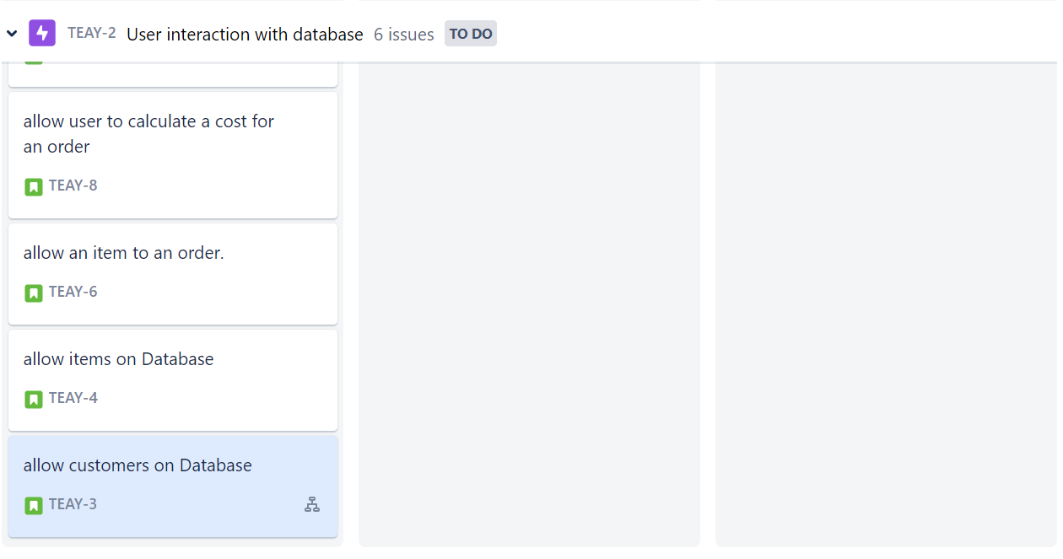
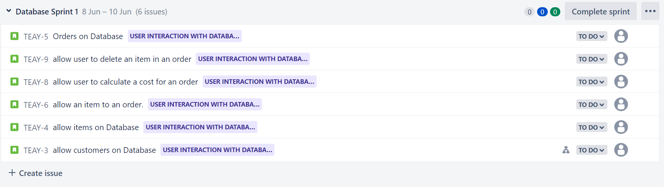
Jira:

Slide 10
Performance review:
-all relevant documentation completed
-tables made using mysql
-errors in code are yet to be resolved and testing is yet to be complete

